Slide 1
Disruptive Technology
Zhanna Kozlova

Slide 2
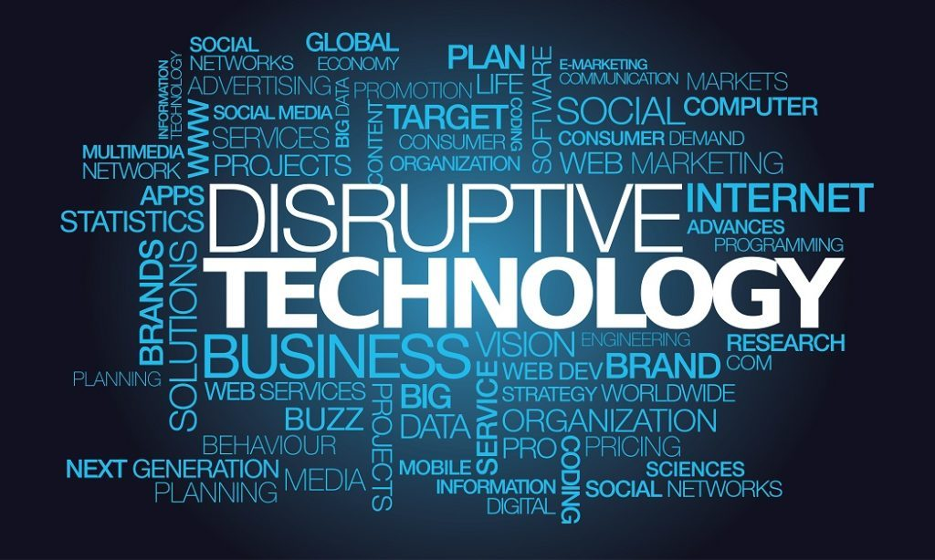

Slide 3
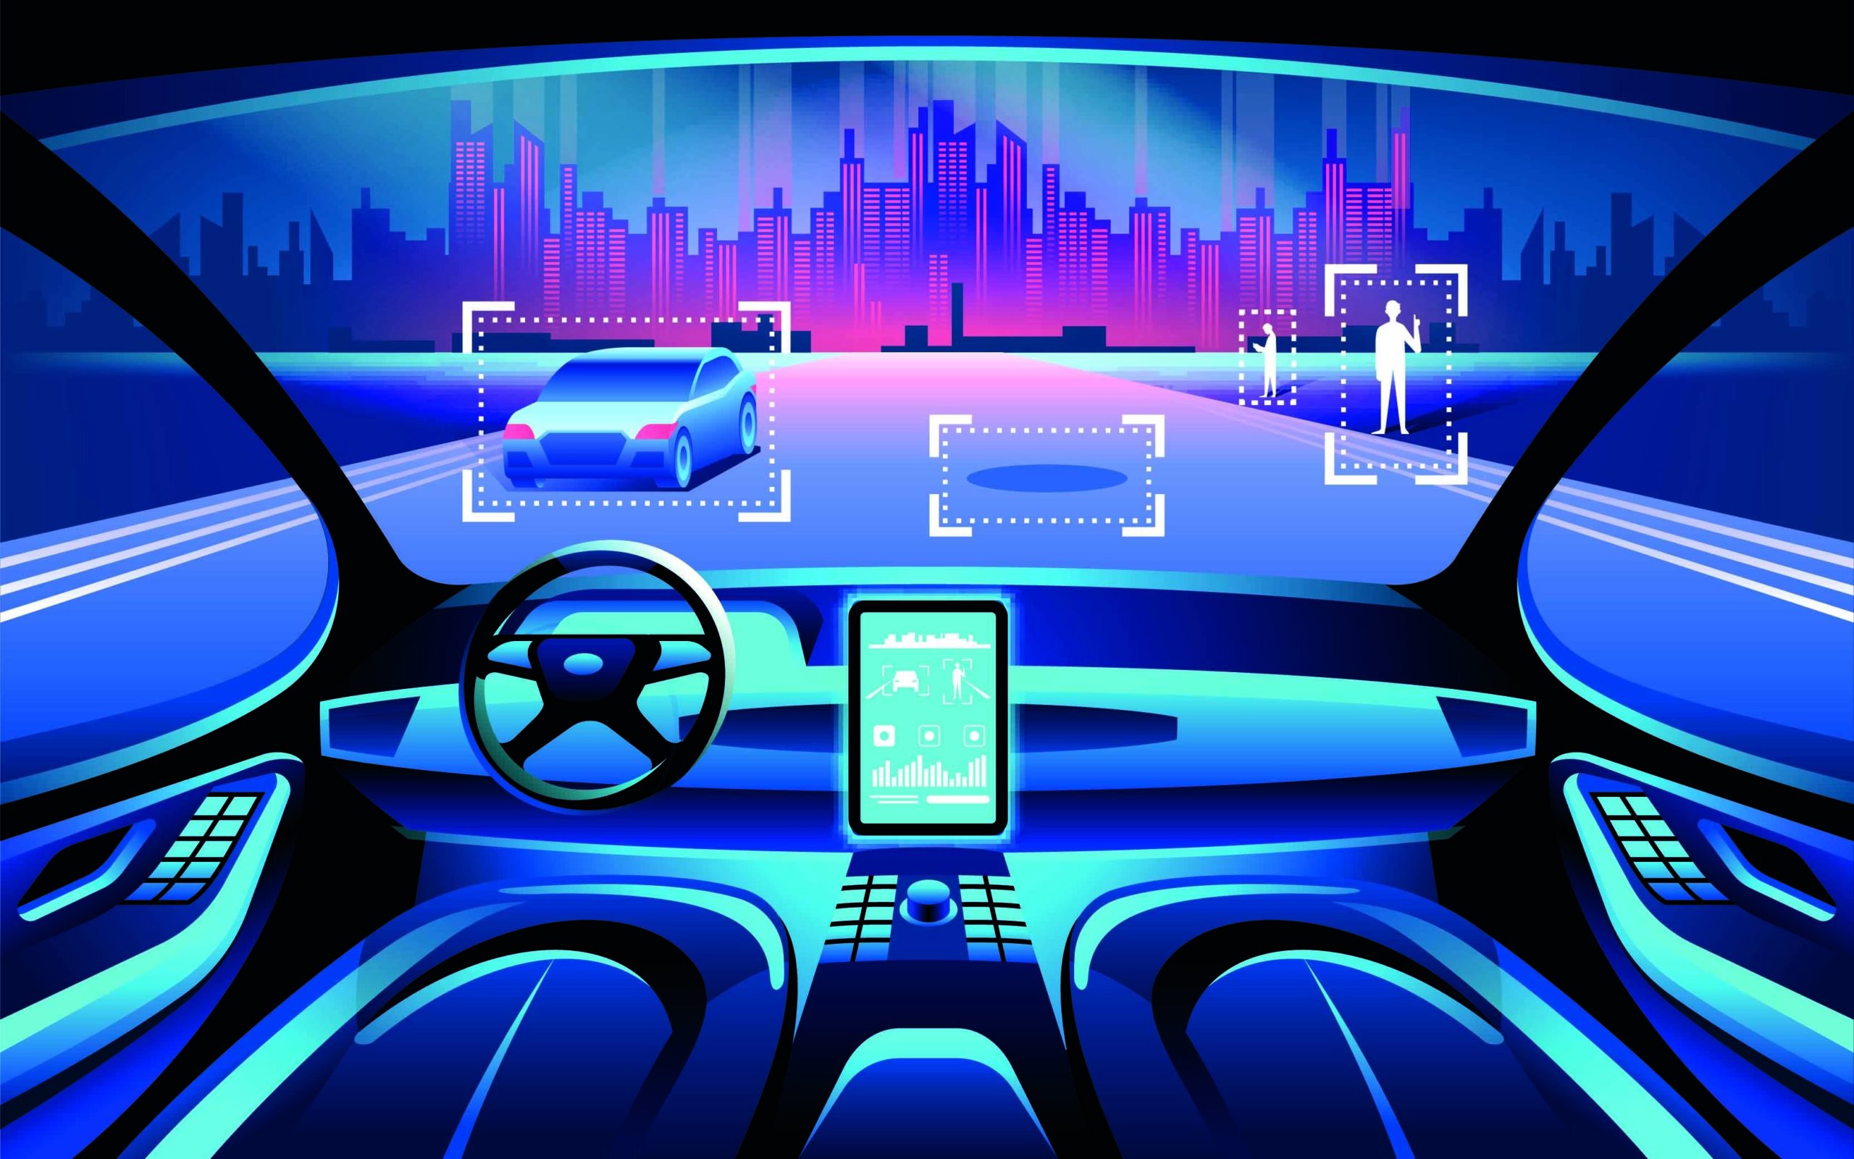
WHAT IS DISTRUPTIVE TECHNOLOGY?
Notes:
Question to the class

Slide 4
“Disruptive technology is an innovation that significantly alters the way that consumers, industries, or businesses operate” (Smith, 2020).

Slide 5
When is something considered a disruptive technology?
A disruptive technology is one that enters the mainstream and changes the way most people think or behave..

Slide 6

Characteristics of disruptive innovation
Worse than existing products or services, but different value propositions;
Lower cost to buy or to use the innovation (lower profits for the innovator);
Initially a niche, then expands into the mainstream market;
Created by start-ups/newcomers.

Slide 7
NEW TECHNOLOGY
Sustaining technology
strives to create products that perform better;
targets customers willing to pay relatively high prices for high-quality products;
relies on high-profit business model.
Disruptive technology
aims to create “good enough” products;
caters to those who are overserved by current product offerings;
relies on a low-cost, low-profit business mode.
VS

Slide 8
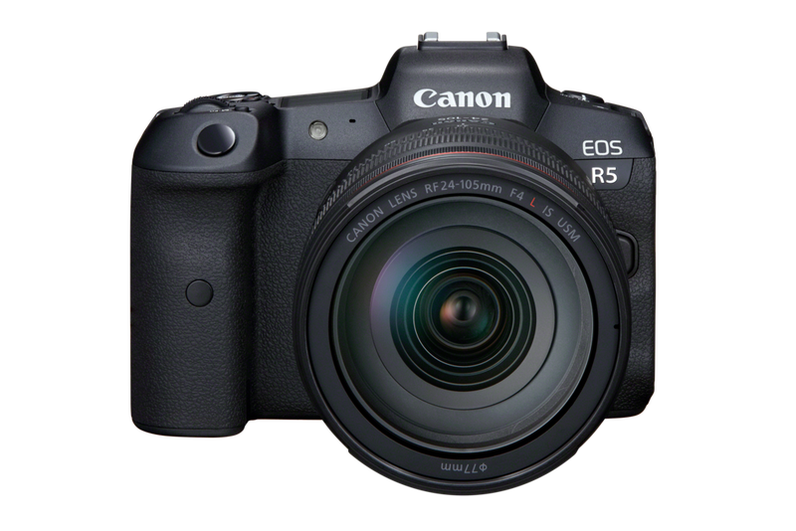
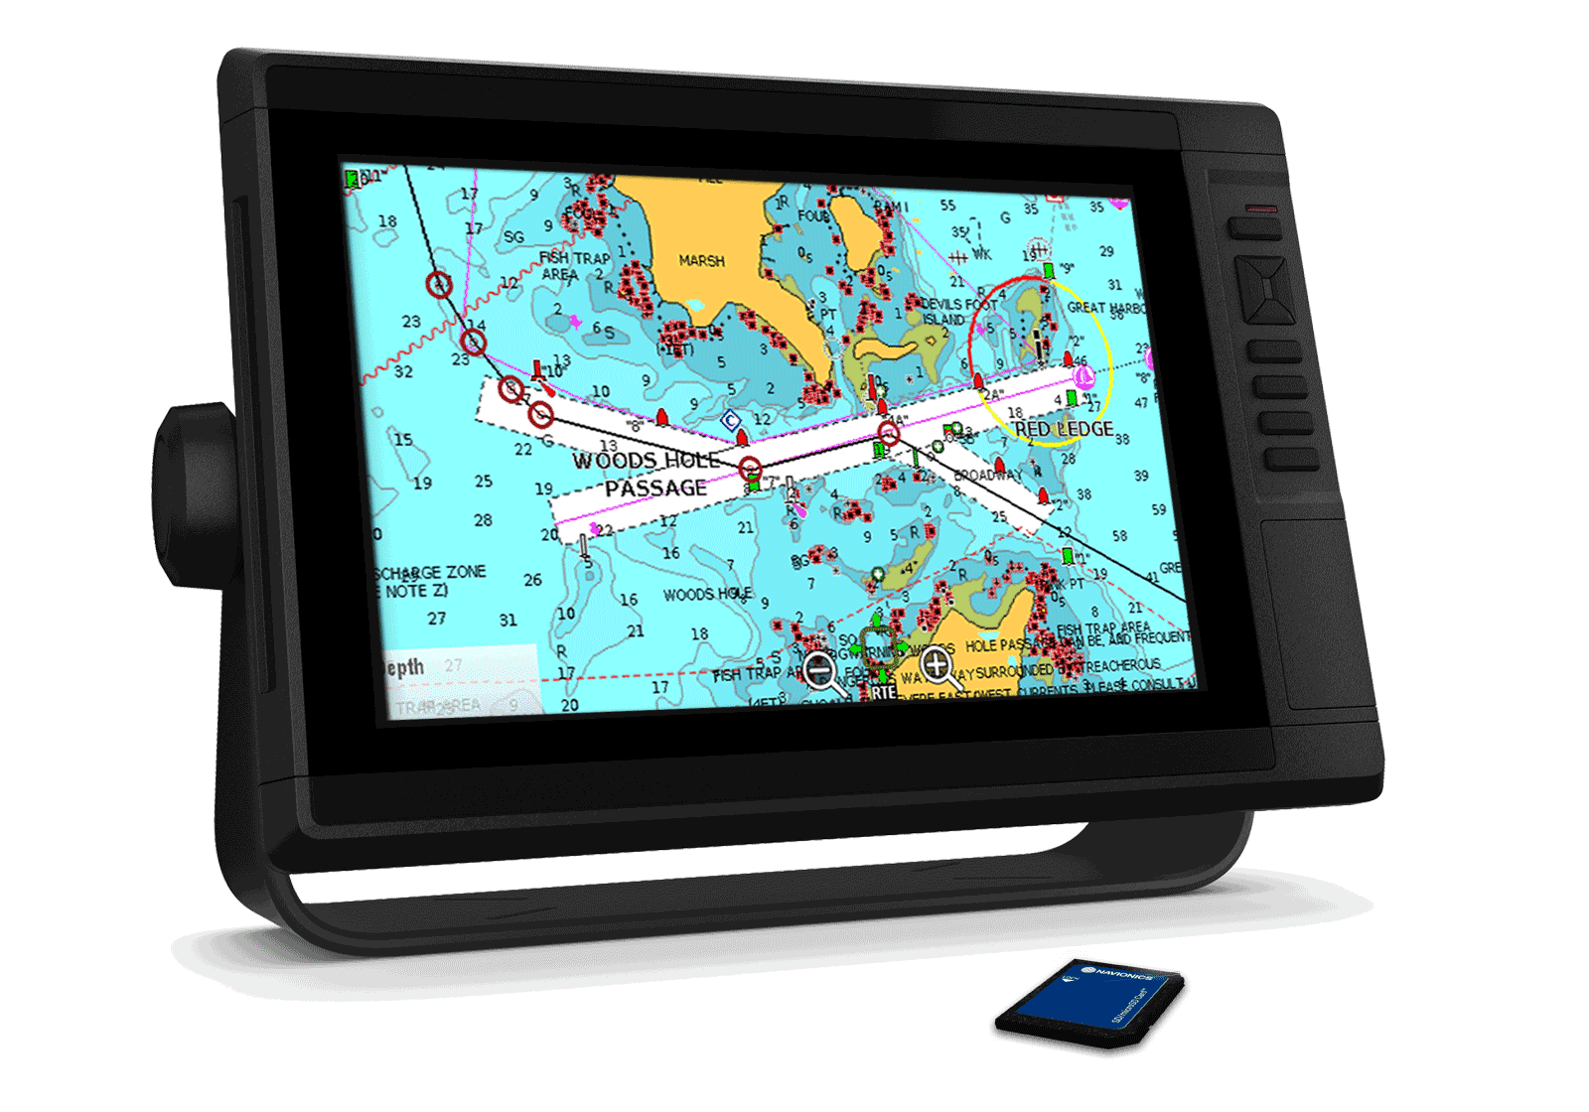


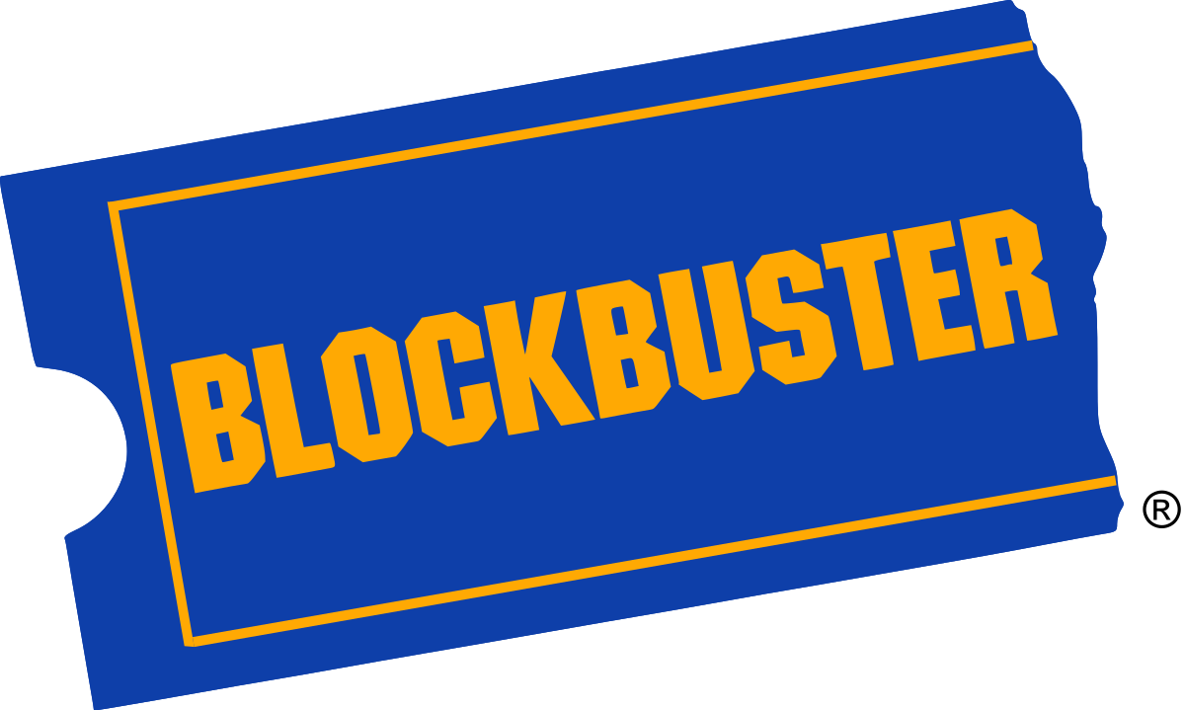
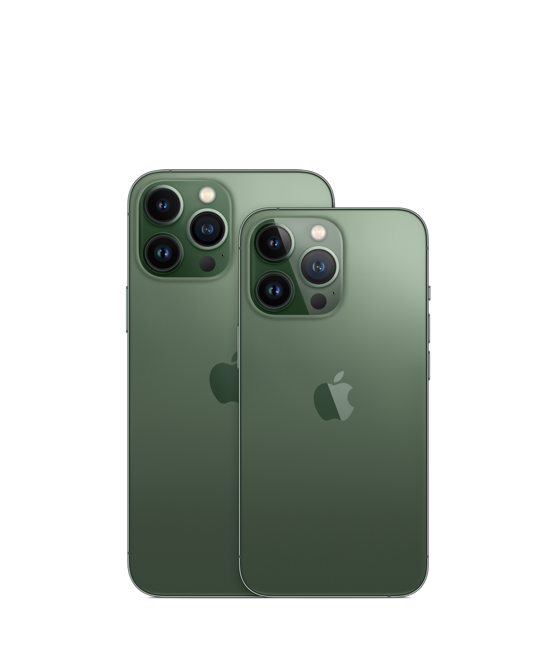




Sustaining innovation
Disruptive innovation

Slide 9
Benefits of disruptive technology
Innovative benefits
Startup opportunities
Room for business growth

Slide 10
Disadvantages of disruptive technology
Unrefined inventions
Early performance problems
Unproven applications

Slide 11
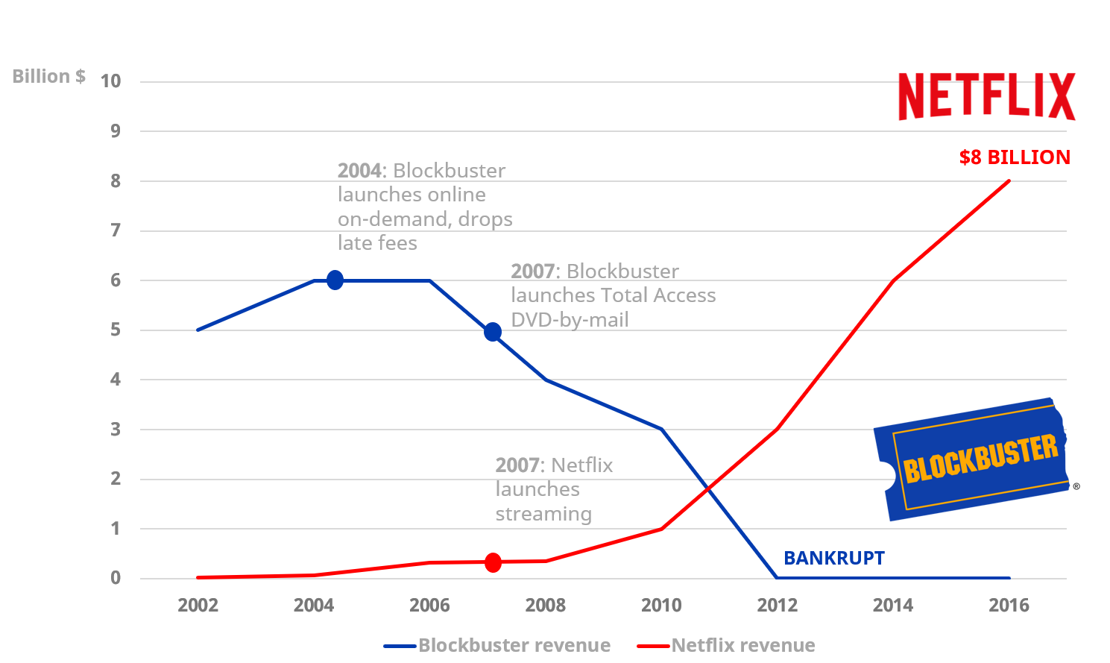

Slide 12
https://www.youtube.com/watch?v=1Tc9YScMtN8&t=1s

Slide 13
The mobile revolution
Worldwide, the growth of connectivity is
rapidly accelerating.
2018, more than 95% of the people in the United States have
cell phones and the vast majority, close to 80% have smart devices
more and more people come online;
easier to stay connected from increasingly
remote locations.

Slide 14
Cloud services
Cloud computing is the use of hardware and software to deliver a service over a network which is usually the internet.
Improves infrastructure security
85% adoption rate.

Slide 15
Data everywhere
The amount of data available is now enormous.
SOLUTION?
PowerPivot and Power BI
Machine learning
Artificial intelligence
Cognitive computing

Slide 16


The Internet of Things
The Internet of things describes physical objects with sensors, processing ability, software, and other technologies that connect and exchange data with other devices and systems over the Internet or other communications networks

Slide 17
E-commerce
Ecommerce is the buying and selling of goods and services over the Internet.
Benefits
?
Drawbacks
?

Slide 18
E-commerce
Benefits
Worldwide market
Lower costs
Specialized business opportunities
Real-time pricing
…
Drawbacks
Drawbacks
Lack of security
Must maintain online presence
Fierce price competition
Shop conflicts
…

Slide 19

Social media networks

Slide 20
Industries disrupted by innovations

Slide 21

ROBOTICS

Slide 22


ROBOTICS
Agriculture
Mining

Slide 23
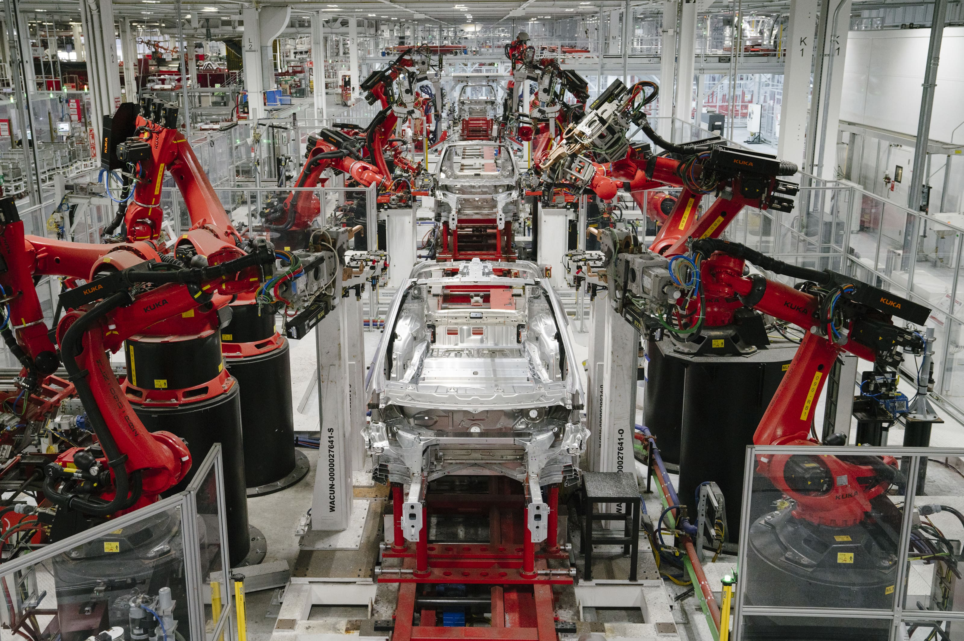
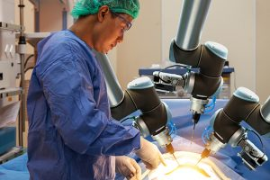
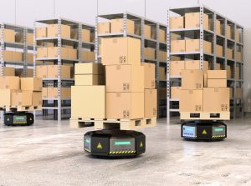
ROBOTICS
Healthcare
Manufacturing
Warehousing

Slide 24

COMPUTER VISION

Slide 25
Advertising/Marketing
https://www.youtube.com/watch?v=7bXJ_obaiYQ
Notes:
https://www.youtube.com/watch?v=7bXJ_obaiYQ

Slide 26
Advertising/Marketing
https://www.youtube.com/watch?v=aj7EYl0G5Q0

Slide 27
RETAIL
https://www.youtube.com/watch?v=NrmMk1Myrxc

Slide 28
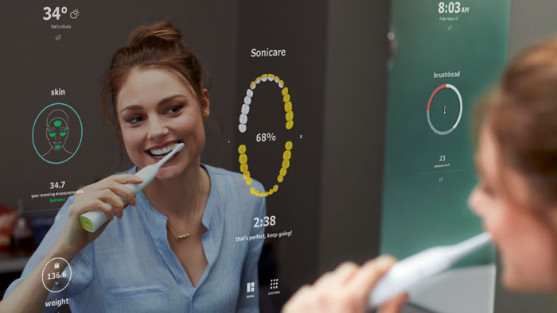
HEALTHCARE
https://www.youtube.com/watch?v=AzXez6sF4LE
Link to Phillips Smart Mirror article

Slide 29
BIOMETRICS
https://www.youtube.com/watch?v=43Og0ZYeF6c&feature=emb_imp_woyt

Slide 30



SPEECH RECOGNITION FOR COMPANIES
Global Speech and Voice Recognition Market will grow
at a CAGR of 17.2% during the forecast period to reach
$26.79 billion by 2025.

Slide 31
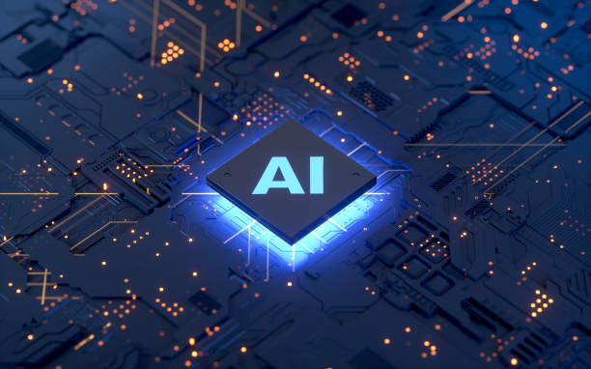
Natural Language Processing (NLP) Applications in Business

Slide 32
Natural Language Processing (NLP)
#1 Machine Translation
#2 Social Media Monitoring
#3 Sentiment Analysis
#4 Chatbots and Virtual Assistants
#5 Text analysis
#6 Speech Recognition
#7 Text Extraction
#8 Autocorrect, Spell Check and Even More

Slide 33
How to prepare for disruption

Slide 34
1. Listen to your customers and observe the industry trends.
How to prepare for disruption
"Success breeds complacency. Complacency breeds failure. Only the paranoid survive.” – Andrew Grove
Ask the right questions and keep the customer at the core

Slide 35
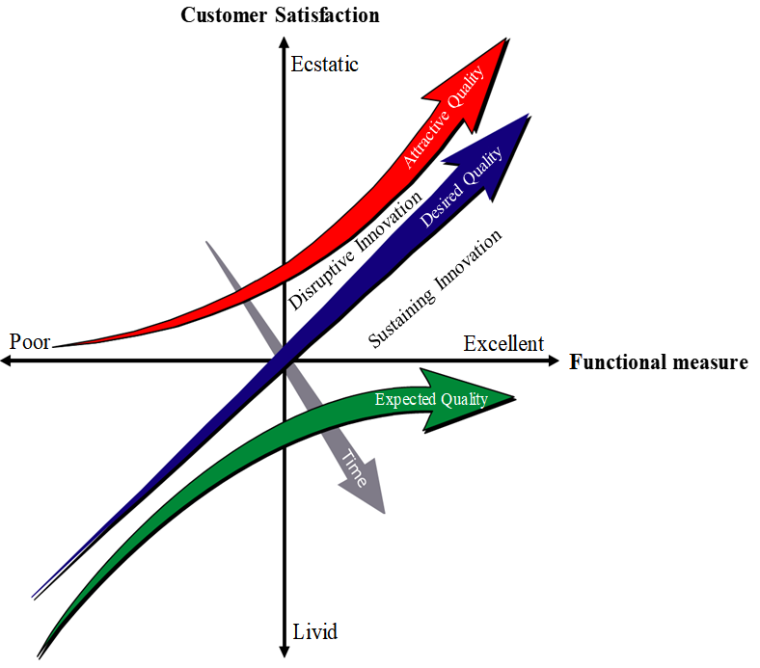
Kano Model
How to prepare for disruption

Slide 36
2. Focus on business model innovation
How to prepare for disruption
Business model innovation - can be used to change how your company delivers value to the customers or captures it from the market.

Slide 37
3. Don't count on breaking through right away
How to prepare for disruption
clear picture of what can be achieved
concrete roadmap

Slide 38
The Three Stages of Disruptive Innovation

Slide 39
The Three Stages of Disruptive Innovation
Idea generation
Generating new ideas is the first stage of successful ambidexterity.
Open Innovation
Corporate Venture Capital
Design Thinking
Employee Involvement

Slide 40





The Three Stages of Disruptive Innovation
Idea generation
Open Innovation

Slide 41
The Three Stages of Disruptive Innovation
Idea generation
Corporate Venture Capital
the objective of corporate venture capital is typically to identify and exploit synergies between the startup and the larger firm and provide opportunities for growth.

Slide 42
The Three Stages of Disruptive Innovation
Idea generation
Design thinking
Design thinking is a methodology for stimulating creativity—a way of generating insights into the real problems faced by customers and rapidly generating prototypes or potential solutions.
Empathize => Define => Ideate => Prototype =>Test

Slide 43
The Three Stages of Disruptive Innovation
Idea generation
Employee Involvement
The direct participation of staff to help an organization fulfill its mission and meet its objectives by applying their own ideas, expertise, and efforts towards solving problems and making decisions.

Slide 44
The Three Stages of Disruptive Innovation
Incubation
Incubation or validation—a process to determine whether the idea meets a market test.

Slide 45
The Three Stages of Disruptive Innovation
Scaling
“Never invest ahead of learning” is a golden rule for scaling.

Slide 46
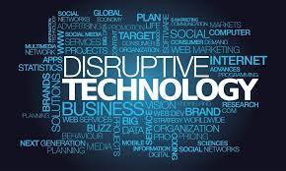
DISTRUPTIVE TECHNOLOGY RISKS

Slide 47
DISTRUPTIVE TECHNOLOGY RISKS
 | Risk categories | Definition
1 | Economic risks | The risk associated with the financial loss that would result from an insufficient or failed DT process.
2 | Time/schedule risk | The risk associated with the likelihood of failing to achieve time/schedule deadline at various stages of a DT development life cycle and the consequence of that failure.
3 | Operational risks | The risk or loss resulting from incomplete/inadequate/failed internal processes, including human resources and organizational dynamics, at various phases of the DT development life cycle.
4 | Customer risks | The risk associated with the loss of the value of the product/technology to the targeted customer segment as a result of certain changes that largely impacts consumer behavior and market trends.
5 | Market risks | The loss associated due to a change in market trend and competitors' activities during the development of the DT or the product arising out of it.
6 | Legal risks | The risks associated with uncertainty in the interpretation or application of contact, regulations, and intellectual properties that DT might require.

Slide 48
DISTRUPTIVE TECHNOLOGY RISKS
 | Risk categories | Definition
7 | Technology risks | Likelihood of failure of a project due to activities related to technical and engineering process, engineering design, technology development, and so on.
8 | Socio – political risks | The uncertainty that an organization might face due to existing internal or external social policies and political issues as well as any sudden changes of the same.
9 | Quality | The risk associated with the disruptive product/technology failing to deliver the desired (or acceptable) level of quality demanded by the targeted market segment.

Slide 49

Risks to Disruptive Innovation and Technology

Slide 50
RISKS TO DISTRUPTIVE INNOVATION AND TECHNOLOGY
#Compliance and Legal Violations
Consumers increasingly want companies to be fully transparent about where their data goes, who sees it, and what
will be done with it.
#Data Breaches
The average cost of a data breach is $3.92 million and affects some 25,000 records.
#User Privacy
Marriot that exposed the personal information of 500 million customers.
# Fairness and Equity
Amazon had reportedly scrapped a machine learning tool for selecting the top resumes among its job candidates
because the system discriminated against women.

Slide 51
RISKS TO DISTRUPTIVE INNOVATION AND TECHNOLOGY
#Reputational Risk
Artificial Intelligence systems that are prone to errors, subject to bias, or easily hacked can expose
your organization to public criticism.
#Spoofed Chatbots
Hackers may be able to place their spoofed chatbot right on the company’s legitimate website.
#Ethical and Legal Concerns
As AI systems become more intelligent and gain more agency, addressing the ethical and legal issues of these
disruptive innovations will be a preeminent concern.

Slide 52
RISKS TO DISTRUPTIVE INNOVATION AND TECHNOLOGY
#Greater Complexity in the Internet of Things (IoT)
Businesses need to make sure that their IoT-connected devices are safe, with no default passwords and
with all security updates installed.
#Public Safety
The massive Northeast blackout of 2003, which affected more than 50 million people, offers a picture
of what could happen in a worst-case scenario during an IoT attack.

Slide 53


